Slide 1
2020 North Central District Virtual Rose Show

Slide 2
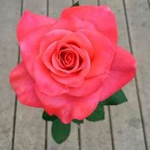
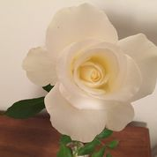
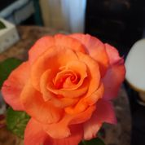
Class 1
Hybrid Tea or Grandiflora – one bloom per stem
1st Prize
Ring of Fire
#18 Donald Bechtle
2nd Prize
Randy Scott
#6 Kaye & Jim Wessbecher
3rd Prize
Touch of Class
#22 Timothy Herrick

Slide 3
Class 2
Floribunda – 1 bloom per stem
2nd Prize
Burst of Joy
#13 Diane Sommers
Ist Prize
Sexy Rexy
#6 Kaye & Jim Wessbecher
3rd Prize
Day Breaker
#18 Donald Bechtle

Slide 4
Class 3
Hybrid Tea or Grandiflora – 1 bloom per stem, fully opened
2nd Prize
Sugar Moon
#10 Lerry Heebsh
1st Prize
Folklore
# 6 Kaye & Jim Wessbecher
3rd Prize
South Africa
#9 Tom Mann

Slide 5
Class 4
1 Hybrid Tea or Grandiflora Spray
1st Prize
Rejoice
#22 - Timothy Herrick

Slide 6
Class 5
Single type bloom ( 4-8 petals), single bloom or spray
1st Prize
Dainty Bess
#3 Diane Rutkowski

Slide 7
Class 6
1 Floribunda Spray
2nd Prize
Magenta
#14 Lois Ann Helgeson
1st Prize
Dancing Pink
#3 Diane Rutkowski
3rd Prize
Glenda Marie
# 10 Larry Heebsh

Slide 8
Class 7
Polyantha, Single bloom or Spray
2nd Prize
Clotilde Soupert
#13 Diane Sommers
1st Prize
Pretty Polly Pink
#15 Robert Fyfe
3rd Prize
The Fairy
#3 Diane Rutkowski

Slide 9
Class 8
Climber, Single Bloom or Spray
Ist. Prize
Stormy Weather
#14 Lois ann Helgeson
3rd Prize
Jasmina
#13 Diane Sommers
2nd Prize
Cherry Frost
#7 Margaret J Anderson

Slide 10
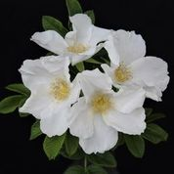
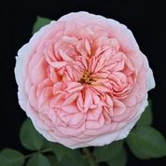
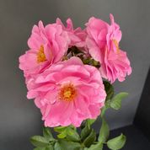
Class 9
Any Shrub rose, single bloom or spray
2nd Prize
Abraham Darby
#10 Larry Heebsh
1st Prize
Wild Spice
#10 Larry Heebsh
3rd Prize
Cape Diamond
#8 Joseph Bergs

Slide 11
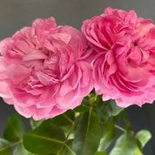
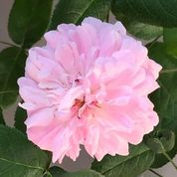
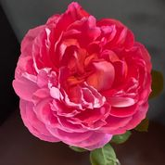
Class 10
Any Old Garden Rose cultivar
2nd Prize
Silver Queen
#14 Lois Ann Helgeson
1st Prize
Baron Prevost
#8 Joseph Bergs
3rd Prize
Paul Neyron
#8 Joseph Bergs

Slide 12
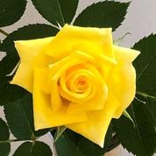
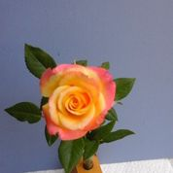
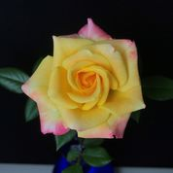
Class 11
1 Bloom per stem, Miniature
1st Prize
The Lighthouse
#14 Lois Ann Helgeson
2nd Prize
Hello Gorgeous!
#20 Lynda and Ken Flemming
3rd Prize
Bees Knees
#3 Diane Rutkowski

Slide 13
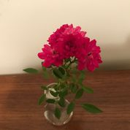
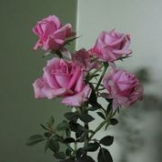
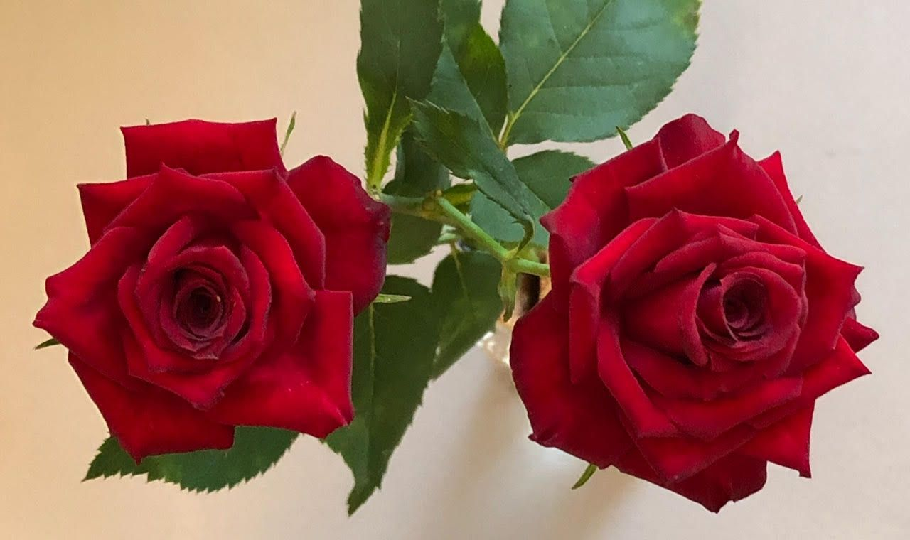
Class 12
1 Miniature Spray
2nd Prize
Chessie’s Favorite
#14 Lois Ann Helgeson
1st Prize
Elfinglo
#6 Kaye & Jim Wessbecher
3rd Prize
Olivia Rose
#5 John Turek

Slide 14
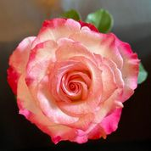
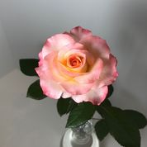
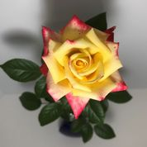
Class 13
1 Bloom per stem, Miniflora
2nd Prize
Princess Katelyn
#20 Lynda and Ken Flemming
1st Prize
Sandy’s Pick
# 8 Joseph Bergs
3rd Prize
Abby’s Angel
#20 Lynda and Ken Flemming

Slide 15
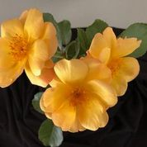
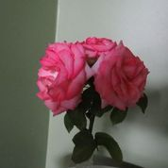
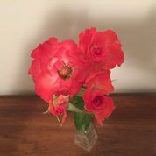
Class 14
1 Miniflora Spray
2nd Prize
Foolish Pleasure
#5 John Turek
1st Prize
Sunglo
#13 Diane Sommers
3rd Prize
First and Foremost
#6 Kaye & Jim Wessbecher

Slide 16
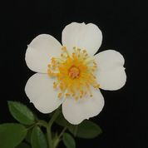
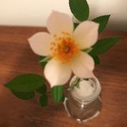
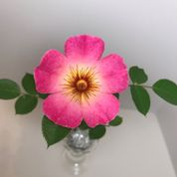
Class 15
1 Miniature or Miniflora Single-type bloom (4-8 petals), single bloom or spray
1st Prize
Little White Lies
# 20 Lynda and Ken Flemming
2nd Prize
Simplex
#6 Kaye & Jim Wessbecher
3rd Prize
Violet Hour
#20 Lynda and Ken Flemming

Slide 17
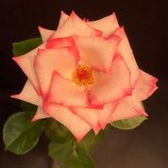
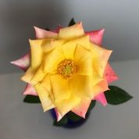
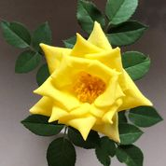
Class 16
1 Bloom per stem fully opened Miniature or Miniflora
2nd Prize
Hello Gorgeous!
#20 #20 Lynda and Ken Flemming
1st Prize
First Choice
#8 Josephs Bergs
3rd Prize
The Lighthouse
#14 Lois Ann Helgeson

Slide 18
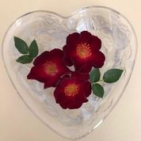
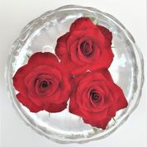
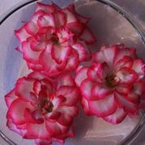
Class 17
Challenge Class – 3 roses floating in a bowl
From any one classification of roses – either the same variety or different varieties
2nd Prize
Daddy Frank
#20 Lynda and Ken Flemming
1st Prize
Maroon Eight
#13 Diane Sommers
3rd Prize
Hannah Gordon
#19 Chris Poppe

Slide 19
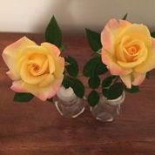
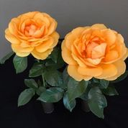
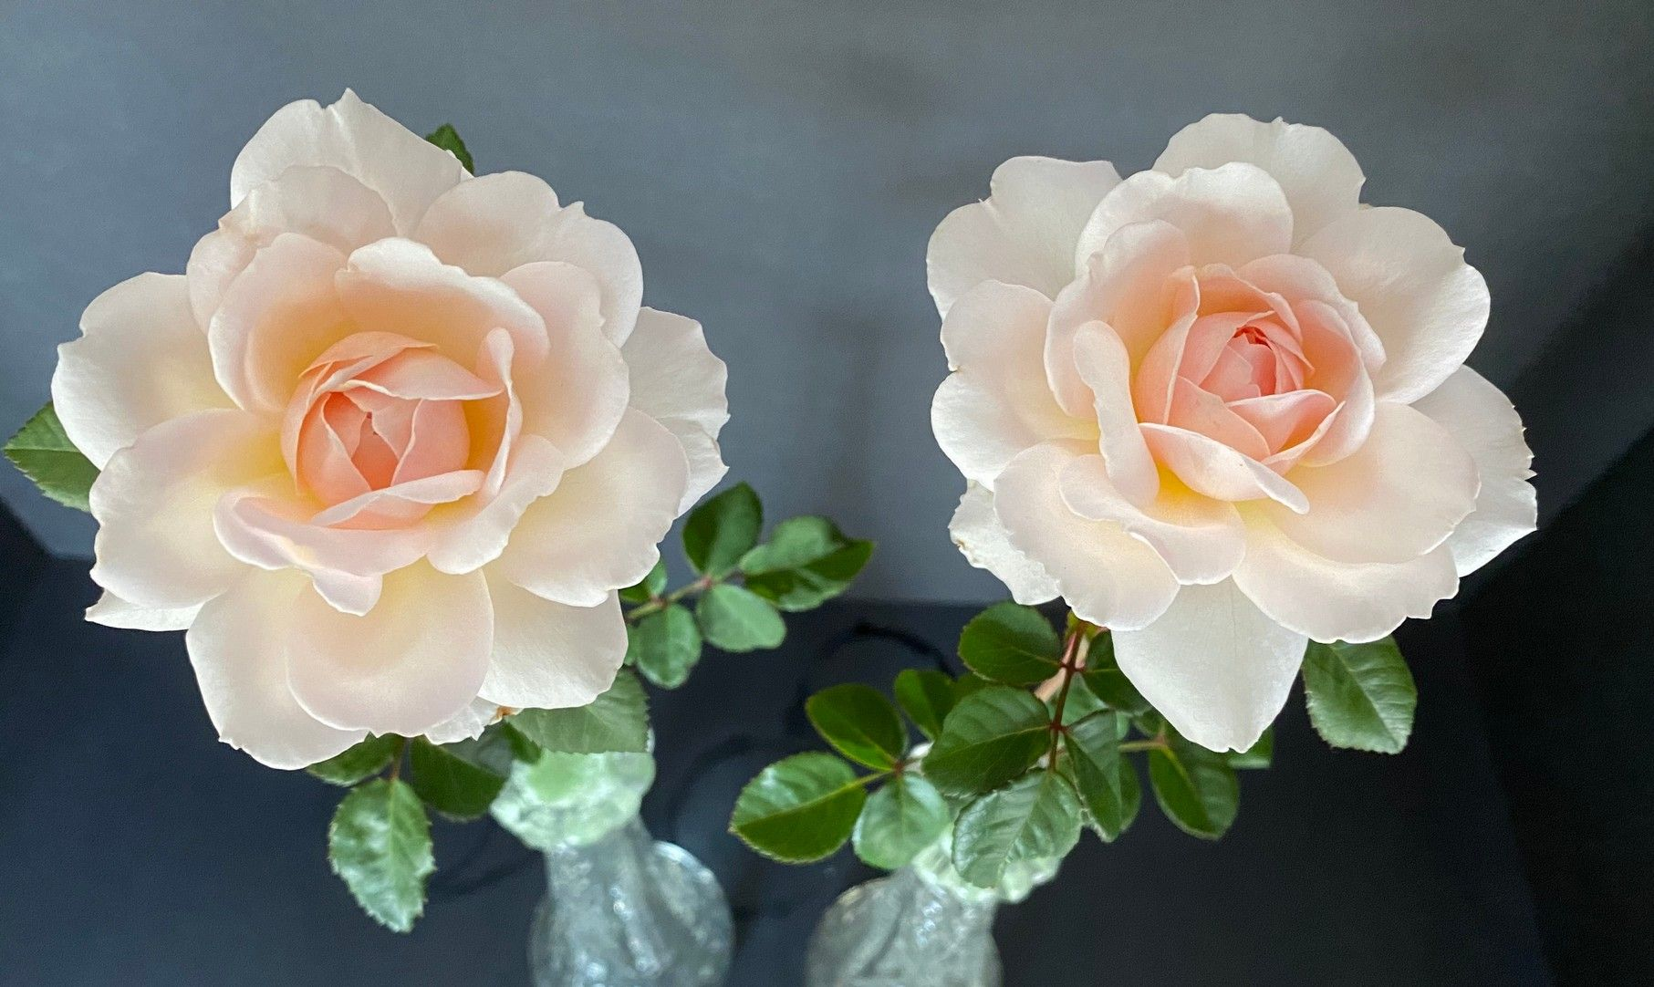
Class 18
Challenge Class - Matched pair of roses
Two, 1 bloom per stem roses, identical in appearance, from any one clssification, shown in separate vases / containers.
1st Prize
Bees Knees
#6 Kaye & Jim Wessbecher
3rd Prize
South Africa
#13 Diane Sommers
2nd Prize
First choice
#8 Joseph Bergs

Slide 20
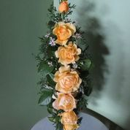
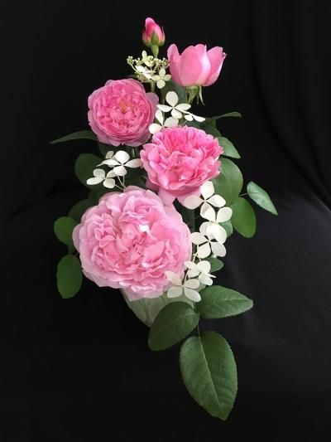
Class 19A
Arrangement – Traditional design – Standard roses
Using some aspect of the conflict between Juneautown, Kilbourne-town and Walker’s Point, create a mass, line-mass or line design.
2nd Prize
Mary Rose
#7 Margaret J. Anderson
1st Prize
Julia Child
#5 John Turek

Slide 21
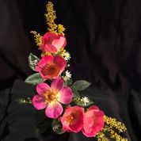
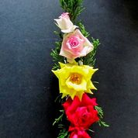
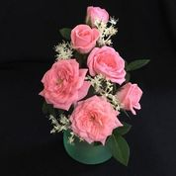
Class 19B
Arrangement – Traditional design – Miniature/Miniflora roses
Using some aspect of the conflict between Juneautown, Kilbournetown and Walker’s Point, create a mass, line-mass or line design.
2nd Prize
Cupcake
#7 Margaret J. Anderson
1st Prize
Violet Hour
#13 Diane Sommers
3rd Prize
Lighthouse
#17 Andy Platz

Slide 22
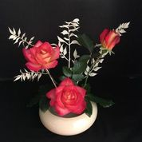
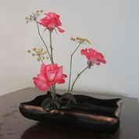
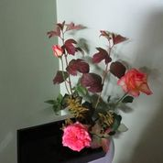
Class 20 A
Arrangement –Oriental design – Standard roses
Reflect the influence of water on the development of Milwaukee.
2nd Prize
Touch of Class
#17 Andy Platz
1st Prize
Rainbow Sorbet
#7 Margaret J. Anderson
3rd Prize
Welcome Home
#5 John Turek

Slide 23
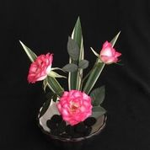
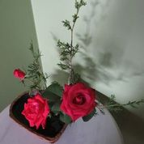
Class 20 B
Arrangement – Oriental design – Miniature/ Miniflora roses
Reflect the influence of water on the development of Milwaukee.
1st Prize
Magic Carousel
#7 Margaret J. Anderson
2nd Prize
Tammy Clemons
#5 John Turek

Slide 24
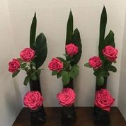
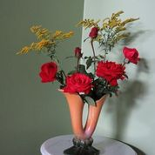
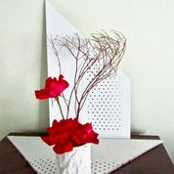
Class 21A
Arrangement – Modern design – Standard roses
Let the Calatrava Art Museum inspire your modern design.
1st Prize
Peter Mayle
#7 Margaret J. Anderson
3rd Prize
In the Mood & Firefighter
#5 John Turek
2nd Prize
Dublin
#17 Andy Platz

Slide 25
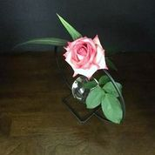
Class 21B
Arrangement – Modern design –Miniature/ Miniflora roses
Let the Calatrava Art Museum inspire your modern design.
1st Prize
FoolishPleasure
#7 Margaret J. Anderson

Slide 26
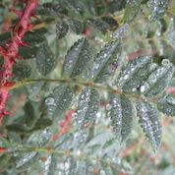
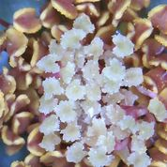
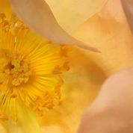
Class 22
Macrophotography of a rose or portion of a rose. Image becomes larger than life.
1st Prize
Dunwich Rose
#17 Andy Platz
3rd Prize
Fighting Temeraire
#7 Margaret J. Anderson
2nd Prize
Chessie’s Favorite
#14 Lois Ann Helgeson

Slide 27
Class 23
Creative interpretation of a rose or parts of a rose – may be digitally changed
2nd Prize
Fighting Temeraire
#7 Margaret J. Anderson
1st Prize
Easy Does It
#1 Ken Lovely

Slide 28
Class 24
Photo of a rose garden – Roses must be part of the picture
1st. Prize
Duluth Rose Garden
Margaret J. Anderson

Slide 29
Class 25 - Judges
3rd Prize
Colorific
#2J- Norma Booty
1st Prize
Nicole
#2J – Norma Booty

